Slide 1

ecommerce Data Insights
Julie leung

Slide 2
Project Purpose and Goals
Data analysis project on data from an ecommerce website.
Provided 4 CSV files of data: products, salesbysku, allsessions, analytics.
Import, Clean, and QA Data (PostgreSQL).
Examine and analyze data, and see what insights can be derived.
Client also asked for 5 specific questions to be answered.

Slide 3
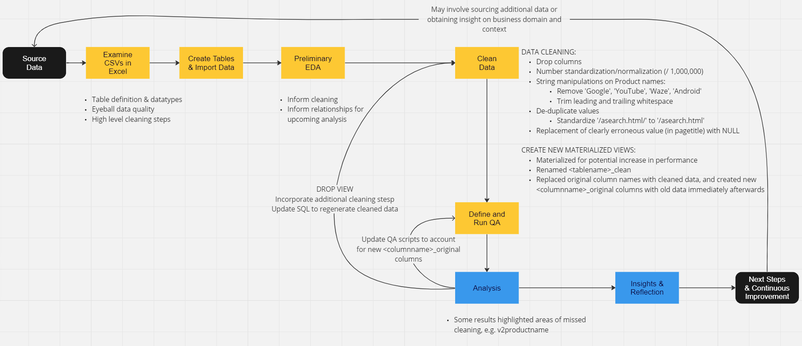
Process Flow
_____________________________________

Slide 4
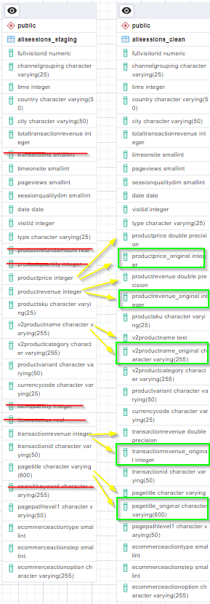
Example Cleaning

Slide 5
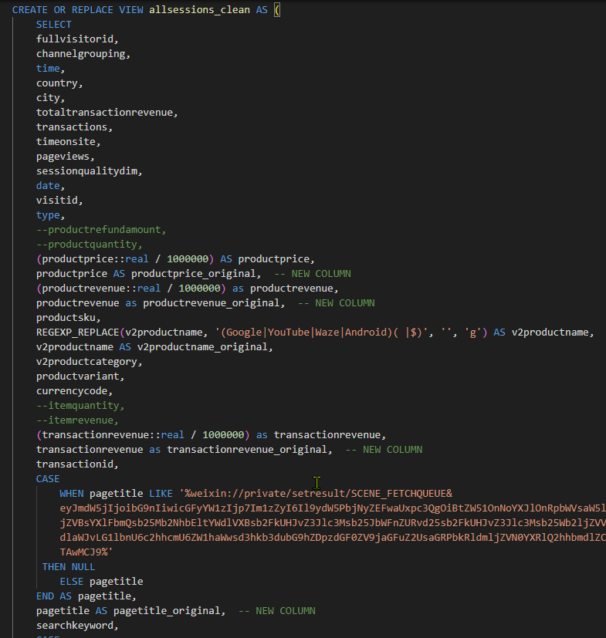
Example Cleaning

Slide 6
Assumptions and Caveats (Dataset Observations)
Data Quality
Quality non-optimal.
Referential integrity and data completeness issues.
Insights derived from the data may not be completely valid.
Increased Inaccuracy Resulting from JOINs Across Tables
Done to obtain combined information for analysis.
May lead to more inaccurate results given differing timespans of data from different tables.
Insights derived primarily from singular tables may yield slightly more valid insights.
Consultant-Generated questions focused on these.

Slide 7
Insights – Consultant
We have an inventory problem.
Inventory and Procurement processes could benefit from process improvement and/or re-engineering to mitigate CSAT impact
15 products with significant negative surplus values.
Purchasing Department top priority should be procuring more of GGOEGFSR022099: “Kick Ball”.

Slide 8
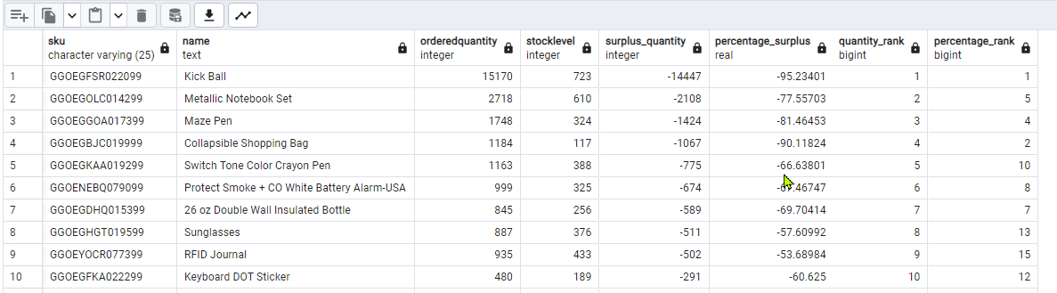
Insights – Consultant

Slide 9
Insights – Consultant
2 most effective marketing channels are “Referral” and “Direct”
Top by both total number of units sold and average price of units sold.
Continue doing what we’re doing with these channels.
“Affiliates” channel has lowest ranking on total units sold, but 3rd highest average price.
Possible quick win to invest in this channel development.
Targeted adjustments towards increasing volume sold could have disproportionate impact.

Slide 10
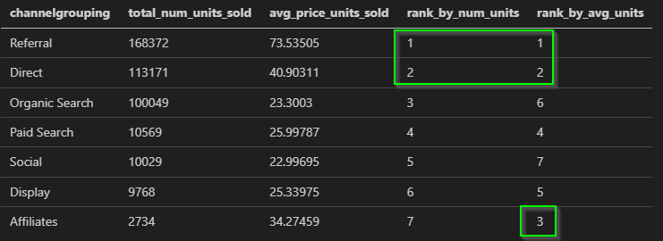
Insights – Consultant

Slide 11
Insights – Consultant
“Top 10 Products Sold” based on total units differs significantly when generating this data from different data sources (1) analytics (unitssold), 2) salesbysku (total_ordered) or 3) products (orderedquantity).
Indoor Security Camera in top 10 regardless of data source. Indicates validity?
Wildly different result sets highlight degree of data inconsistency.
Invites a revisit with cleaner data and additional investigation time.

Slide 12
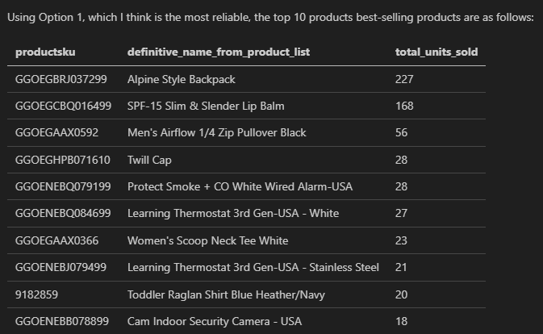
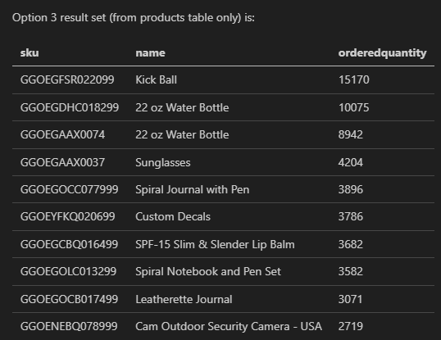
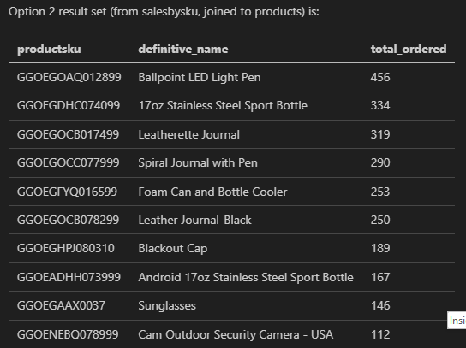
Insights - MINE

Slide 13
Insights – Consultant
No obvious trending pattern for dates with higher-than-average visits.
Data set limited to 2017 May – August.
Highest visits (over average) around May Long Weekend. Targeted marketing to translate to sales?

Slide 14
Insights – Client Questions
Highest transaction revenue (driven by “unitssold” values from analytics) in “Unknown” location → shows extent of missing location data.
Top 9 highest transactions from US → possibilities for growth from other locations, potential relative saturation in US.
No obvious patterns apparent to “naked eye” for the below questions (result sets in report) → follow-on statistical or graphical analysis valuable; definite need for data integrity improvements (analytics.unitssold averages 1.xx causes switch to using quantities from allsessions, products, salesbysku):
Average number products ordered each city, country
Categories of products ordered from each city, country
Best-selling products per city, country
Effect of Revenue on “Impact” (using sentimentscores * sentimentmagnitudes * quantity)
“Revenue effect on Impact?” → value in obtaining true impact data such as dollars invested in community infrastructure, dollars invested in charity, employment statistics in countries in which we operate.

Slide 15
QA Process
Three major types:
To confirm integrity after automated data cleaning.
SQL run as preliminary exploratory data analysis (EDA) to understand:
What columns might be set as PK/FK
What columns can be used to JOIN tables even if PK/FK constraints not met
To confirm that import into PostgreSQL was complete (row count excluding headers).

Slide 16
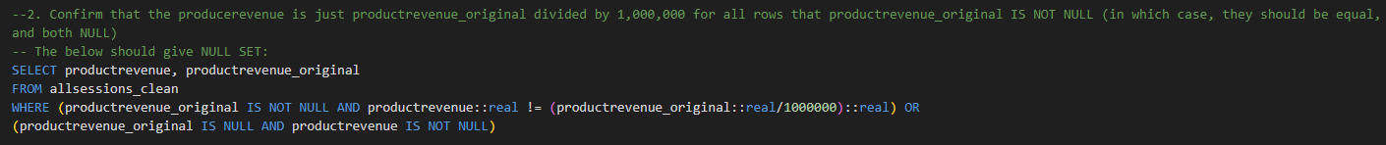
QA
Example: Confirm column transformation correct for every row:

Slide 17
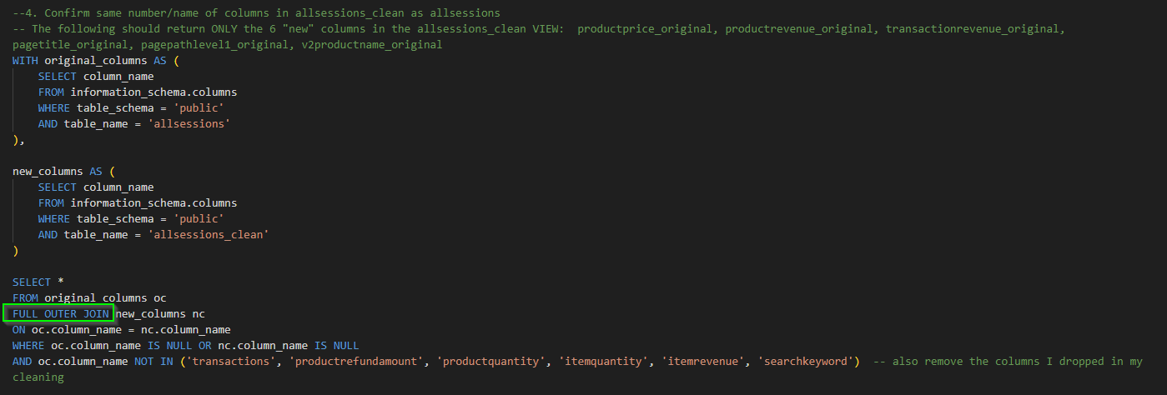

Example: Confirm correct number and name of columns in allsessions_clean as allsessions using information_schema metadata:

Slide 18
Next Steps
For Further Investigation:
- More thorough data cleaning: outlier detection and removal
- Confer with “the business” to understand:
additional cleaning steps
which tables valid for which questions
augment existing data
-Graphical visualization or statistical analysis of some results for significant but subtle trends where results inconclusive to “naked eye”:
Average num products ordered per city, country (Client Q2)
# products ordered per category for each city, country (Client Q3)
Top selling product in each city, country, Q4

Slide 19

Questions?

Slide 20
Back-Up Slides

Slide 21
Insights
Highest transaction revenues – mostly from US in top 9. Largest number is from “Unknown” demonstrating poor quality of data]. Could focus on other parts of world, maybe US approaching saturation
No obvious pattern for avg num products ordered in each city, country. Indicates missing data for city needs to be fixed to get better insights, and that analytics unitssold data is not likely accurate (1.xxx averages), so switched to use of allsessions/salesbysku/products. Highlights graphical repersentations needed.
No obvious eyeball patterns for categories of products ordered from each city/country (q3) and best-selling products per city/country (q4). Histogram and statistical analysis to see better, and more reliable location data.
Guesses at “impact” question – using sentiment scores/magnitude * quantity. No clear correlation between revenue and “fake impact calc”. Would be more interesting if we had true impact data like investment in community infrastructure, charities, employment #s.

Slide 22
Assumptions and Caveats (Dataset Observations)
Transaction revenues using analytics, shifted gears to using allsessions because analytics.unitssold “filtering for rows where unitssold is > 0 OR NOT NULL cuts out more than 3M rows of usable data, and gives us mostly tiny averages of 1.xxx.”
For Q2-4 used:
Join allsessions, salesbysku, products
LEFT JOINS to preserve max rows from allsessions
“on the fly” data clean on joined dataset:
priority salesbysku.total_ordered >> products.orderedquantity
Priority products.name >> (cleaned) allsessions.v2productname
“on the fly” data clean on cities, countries for more meaningful grouping/results

Slide 23
Assumptions and Caveats (Dataset Observations)
My querying sticks to one table (products) (2 Q, #1/#2), analytics (2 Q, #3/#5), as MAYBE it is more accurate to stick to one table and not joins where there isn’t referential integrity and there are differing numbers (such as analytics.unitssold/salesbysku.total_ordered/products.orderedquantity)
Top 10 products sold: 3 different slices of the data/tables:
MOST ACCURATE: primarily using analytics (joining to products to get product name) and inner join to allsessions to “credify” analytics rows (limit to those that have supporting rows in allsessions).
Salesbysku table (singular table only) to see how it compares
Products table only to see how it compares
Dataset (analytics) only from May-June-Aug 2017 so is limited. No idea what dates salesbysku covers or products. Allsessions is wider date range (1 year 2016 08 01 to 2017 08 01)

